Slide 1

CACHE MEMORY ORGANIZATION
CACHE MEMORY ORGANIZATION

Slide 2
INTRODUCTION
Every computer contains several types of memory devices to store the instructions and data required for its operation.
The memory devices of a computer system are of four types
i) CPU registers
ii) cache memory
iii) main memory
iv) secondary memory
The main memory stores the programs and data that are in active use. The main memory operates at very low speed as compare to CPU . The cache memory serves as a buffer between the main memory and the CPU so that the CPU can operate near to its maximum speed.

Slide 3
BLOCK DIAGRAM OF A MEMORY UNIT
A memory unit is a collection of storage cells with associated circuits needed to transfer information in and out of the device.
RAM
m
2^{m} ×w
w
Address A
Data D
Output enable OE
Write enable WE
Chip select CS
(fig-1 2^{m} ×w-bit or 2^{m} –word memory)

Slide 4
A memory unit is a collection of storage cells with associated circuits needed to transfer information in and out of the device.
The fig-1 shows a 2^{m} ×w-bit RAM IC and its control lines.
The RAM has m-bit unidirectional address bus A and w-bit bidirectional data bus D.
The three control signals are
1. Write enable line (WE)
2. Chip select line (CS)
3. Output enable line (OE)

Slide 6
MEMORY ADDRESSES
Binary
decimal
Memory contest
10101111001000111
1000111111001010
1000101011110001
……
..….
1111001101011010
1100110010101111
1110110010101100
0000000000
0000000001
……
……
1111111101
1111111110
1111111111
0
1
…..
…..
1021
1022
1023
(Fig-2 Content of a 1024×16 Memory)

Slide 7
The memory unit is specified by the number of words it contains and the number of bits in each words. The address lines select one particular word.
Each word in memory is assigned an identification number called an address , starting from 0 up to 2^{k} -1.where k is the number of address lines.
The selection of a specific word inside memory is done by applying the k-bit address to the address line.
A decoder accepts this address and opens the path needed to select the word specified.
.

Slide 8
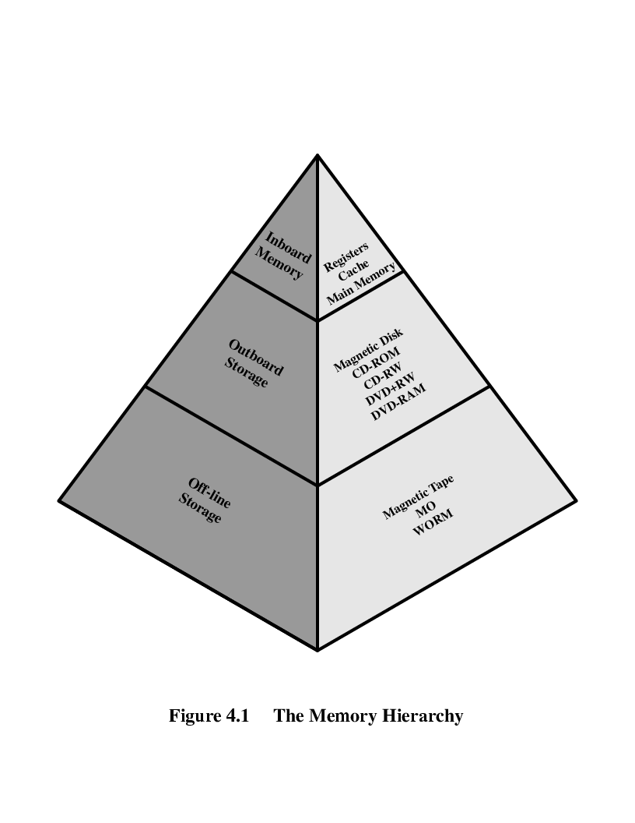
MEMORY HIERARCHY
(fig-3 memory hierarchy)

Slide 9
The computer memory is organized in to a hierarchy.
i) Inboard memory-These are internal to the computer
a) CPU registers- High speed memory located with in the CPU and are less in number.
b) Cache memory-Logically positioned between the CPU and main memory. Its storage capacity less than main memory and is faster than main memory.
c) Main memory-It stores the program that are in active use. Accessing data from main memory is slower because of its large capacity.
ii) Outboard storage- It can not be accessed directly by the CPU.
a) Magnetic disk-It is much larger in capacity and slower than main memory.
It stores the system programs, large data files that are not continuously required by the CPU.
iii) Offline storage-It is a data storage device that are not under the control of a processing unit.
a) Magnetic tap- Information stored here are rarely accessed ,off-line storage is less expensive than secondary storage .

Slide 10
Three main characteristics of memory are
1. capacity
2.access time
3. cost
If one go down the memory hierarchy the following occur:
Decreasing cost per bit Co1 > Co2 > Co3 > Co4 >Co5 >Co6
Increasing capacity Ca1 < Ca2 < Ca3 < Ca4 < Ca5 <Ca6
Increasing access time t1 < t2 < t3 < t4 < t5 < t6
Decreasing frequency of access of the memory by the processor
f1 > f2 > f3 > f4 > f5 > f6

Slide 11
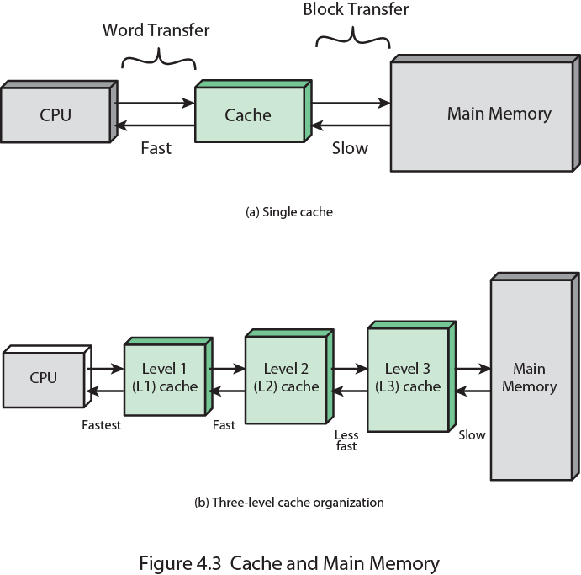
CACHE MEMORY
Cache memory serves as a buffer between the CPU and main memory. It is intended to give faster memory speed and a larger memory capacity at less price.
(Fig-4 cache memory and main memory)

Slide 12
The (fig-4 a) shows a relatively large and slow main memory together with a smaller and fastest cache memory.
The (fig-4 b) shows the use of multiple levels of cache . The L2 cache is slower and typically larger than L1 cache, and L3 cache is slower and typically larger than the L2 cache.
Cache hit- when the CPU finds a requested data item in the cache, it is called cache hit.
Cache miss-when the CPU does not find a data it needs in the cache, it is called cache miss.
Hit ratio-It is the percentage of data found in the cache.
Access time-It is the total time taken to bring the required data form the memory to CPU.

Slide 13
In the figure -4(a) if
t1= time required to read from cache memory
t2= time required to read from main memory
h = is the hit ratio
Access time = h*t1 + (1-h)*(t1+t2)
In the figure-4(b) if
t1=time required to read the data from L1 cache
t2= time required to read the data from L2 cache
t3= time required to read the data from L3 cache
t4= time required to read the data from main memory
h1=hit ratio in L1 cache
h2=hit ratio in L2 cache
h3=hit ratio in L3 cache
Access time = h1t1 + h2(1-h1)(t1+t2) + h3(1-h1)(1-h2)(t1+t2+t3) +
(1-h1)(1-h2)(1-h3)(t1+t2+t3+t4)

Slide 14
CACHE ORGANISATION-
Address Control Data
( figure- 5 Basic structure of a cache )
The above fig shows the principal components of a cache . Memory words are stored in a cache data memory and are grouped into small pages called cache blocks or lines. The contents of the cache’s data memory are thus copies of a set of main memory blocks. Each cache block is marked with its block address referred to as tag.
Hit
Cache data memory
Cache tag memory

Slide 15
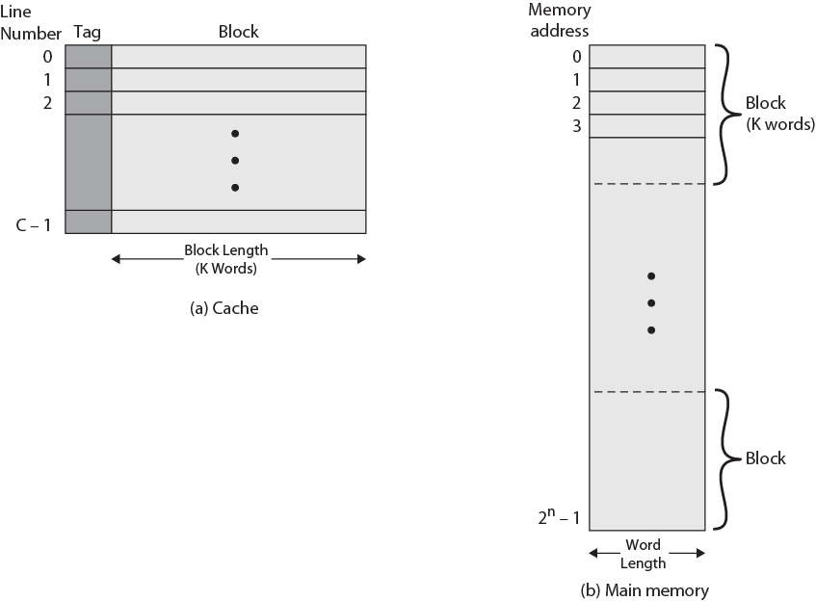
CACHE AND MAIN MEMORY STRUCTURE
(Fig-6 Cache/Main Memory Structure)

Slide 16
The Fig-7 depict the structure of a cache/main memory consists of up to 2^{n} address words , with each word having a unique n-bit address.
For the mapping purposes memory is considered to consist of a number of fixed length blocks of K word each.
There are M= 2^{n} /K blocks , called lines. Each line contains K words , plus a few tag bits each.

Slide 17
MAPPING MEMORY TO CACHE
There are fewer cache lines than main memory blocks so an algorithm is needed for mapping main memory blocks into cache lines.
Three techniques can be used
1. Direct mapping
2. Set associative mapping
3. Fully associative mapping

Slide 18
DIRECT MAPPING
In direct mapping is the simplest technique . It maps each blocks of main memory into only one possible cache line . The mapping is expressed as
P=K module N
Where P=cache line number
K=main memory block number
N=number of lines in the cache
The Kth block of main memory has to be placed in (KmodN) th cache position.
The physical address is divided into three field
physical address
TAG
CACHE BLOCK EFFECT
WORD EFFECT

Slide 19
Direct Mapping Cache Line Table
Cache line | Main Memory blocks held
0 | 0, m, 2m, 3m…2s-m
1 | 1,m+1, 2m+1…2s-m+1
…
m-1 | m-1, 2m-1,3m-1…2s-1
(Fig-7 Direct mapping cache line table)

Slide 20
Explanation of Direct mapping-
MM=512 words
0
CM=64 words 1 mod 4 1
00
011
1
01
001
111
9
10
110
11
001
29
N=4 blocks
30
31
M=32 blocks
(Fig-8 Direct mapping cache)

Slide 21
Let the main memory size MM = 512 words
The cache memory size CM = 64 words
The block size = 16 words
Then Number of blocks in main memory
M = MM/block size =152/64 = 32 blocks
Number of blocks in cache memory N = CM/block size=64/16 = 4 blocks
Number of blocks in a particular cluster = M/N = 32/4 = 8
TAG 000 001 010 011 100 101 110 111 Cache Memory
Main Memory { 0, 4, 8, 12, 16, 20, 24, 28 } ---→ 0 00 Blocks
blocks { 1, 5, 9, 13, 17, 21, 25, 29}---→ 1 01
{ 2, 6, 10, 14, 18, 22, 26, 30}---→ 2 10
{3, 7, 11, 15, 19, 23, 27, 31}---→ 3 11
Let the cache the block number – 5 , 7, 12 , 26

Slide 22
Example – 1
Suppose the processor want to access the data content in physical address
(400)10 from the memory. Find out whether it is a cache hit or a miss.
Sol-
The binary equivalent of (400)10 =(110010000)2
since 110 is not present in the cache block number 01. so it is miss
TAG=log(M/N) cache word offset
block log(P)
offset
log N
1 1 0
0 1
0 0 0 0

Slide 23
Example-2
The processor want to access the data content in memory location (199)10.
We have to find whether it is a hit or a miss.
Explanation-
Binary equivalent of (199)10 = (011000111)2
The tag bit 011 present in the block no 00 . So it is a hit.
Advantages-
1. simplest mapping technique.
2. Less number of tag bits and less tag comparator required.
Disadvantages-
1. It is a slowest mapping technique and requires more block movement.
0 1 1
0 0
0 1 1 1

Slide 24

ASSOCIATIVE MAPPING
In associative mapping any block of main memory can be placed any where in cache memory . In this case, the physical memory address can be divided as a tag and a word field.
The tag field uniquely identifies a block of main memory. To determine whether a block is in cache or not, each cache blocks are to be tested. Hence the number of tag comparator is equal to number of cache blocks.
physical address
log M = s log P = w
TAG
Word offset

Slide 25
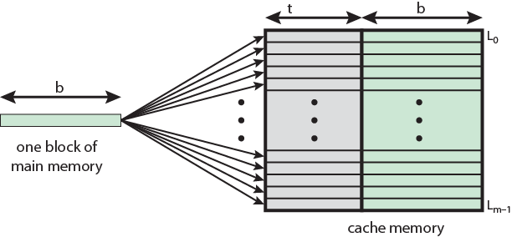

Address length = (s + w) bits
Number of addressable units = 2^{(s+w)}
Block size = line size = P = 2^{w} words or bytes
Number of blocks in main memory = M=2^{s}
Size of tag = s bits
Advantages-
1. Each block of main memory can be mapped in to any block of cache memory.
Disadvantages-
1. More tag bits are there and hence more TAG memory required.
2. More comparator required and hence it is more costly.
(Fig-9 associative memory mapping)

Slide 26
SET ASSOCITIVE MAPPING
The set associative mapping is having the advantages of both direct mapping and associative mapping.
Here the cache is divided into logical sets.
In 4-way set association each set is allocated with four cache blocks.
The physical address is divided into three fields.
1. word offset
2. set offset
3. tag information
physical address
log (MK/N) log K log P
TAG
Set offset
Word offset w

Slide 27
The cache consists of a number sets, each of which consists of a number of lines. The relationships are
m = v * k
i = j modulo v
Where
i = cache set number
j = main memory block number
m = number of lines in the cache
v = number of sets
k = number of lines in each set
This is referred to as k-way set-associative mapping

Slide 28
Explanation of Set associative memory
MM=512 words
0
sets CM= 64 words
0mod2 1
0
0111
1
1001
111
9
1101
1
0101
29
N=4 blocks
30
31
M=32 blocks
(Fig-10 Set associative cache memory)

Slide 29
The above figure shows a 2-way set associative memory
Let the main memory size MM = 512 words
The cache memory size CM = 64 words
The block size = 16 words
Then Number of blocks in main memory
M = MM/block size =152/64 = 32 blocks
Number of blocks in cache memory N = CM/block size=64/16 = 4 blocks
Number of set = 2
Number of blocks in a particular set = 2
TAG
0000 0001 0010 0011 0100 0101 0110 0111 1000 1001 1010 1011 1100 1101 1110 1111
0 2 4 6 8 10 12 14 16 18 20 22 24 26 28 30 set0 1 3 5 7 9 11 13 15 17 19 21 23 25 27 29 31 set1

Slide 30
Example- 1
The processor want to access the data of memory location (122)10 . Find whether it is a hit or a miss.
Solution-
The binary equivalent of (122)10 = (001111010)2
. Tag set offset word offset
The set no ‘1’ does not contain the tag bit 0011. So it is a miss.
0 0 1 1
1
1 0 1 0

Slide 31
Example-2
The processor want to access the data of the memory address
442.Find whether it is a hit or miss.
Solution-
The binary equivalent of (442)10 = (110111010)2
The tag bit 1101 is present in the set no 1.So it is a hit.
Advantages-
1. Number of TAG comparator required is equal to the number of blocks with in a set.
Disadvantages-
1. Complex in structure.
1 1 0 1
1
1 0 1 0

Slide 32
UPDATION TECHNIQUE
The site effect of memory hierarchy is the data inconsistency . Same information is available differently at different places.
Proper updation technique reduce this problem.
Write-back updation
Write-through updation
Write-back updation
Here the cache act like a buffer by receiving data from the processor and writing data back to main memory whenever the system bus is available.
Advantage-
The processor is freed up to continue with other tasks while main memory is updated at later time.
Disadvantage-
The cost and complexity of cache subsequently increase.

Slide 33
Write through updation
The processor handles write to main memory instead of the cache.
The cache may update its contents as the data comes through from the processor. The write operation does not end until the processor has write the data back to main memory.
Advantage-
The cache does not have to be complex , which thus makes it less expansive.
Disadvantage-
The processor must wait until the main memory accepts the data before moving on to its next task

Slide 34
CONCLUSION-
The goal of memory hierarchy is to obtain a cost per bit close to that of the least expansive memory and access time close to that of the fastest memory.
To reduce the speed difference between CPU and main memory cache memory is used.
Various updation techniques are used to maintain the consistency of data in memory.

Slide 35
THANK YOU

